Slide 1

ECE2700J SU24 Mid RC
Wenyue Li
6/19/2024

Slide 2
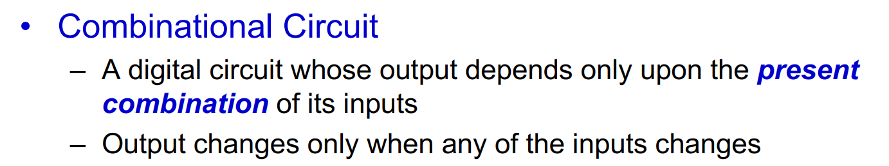
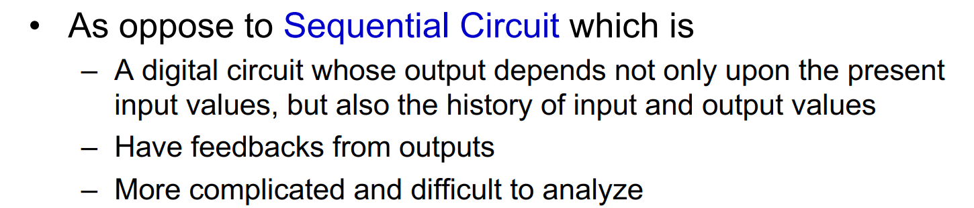
Combinational Circuit

Slide 3
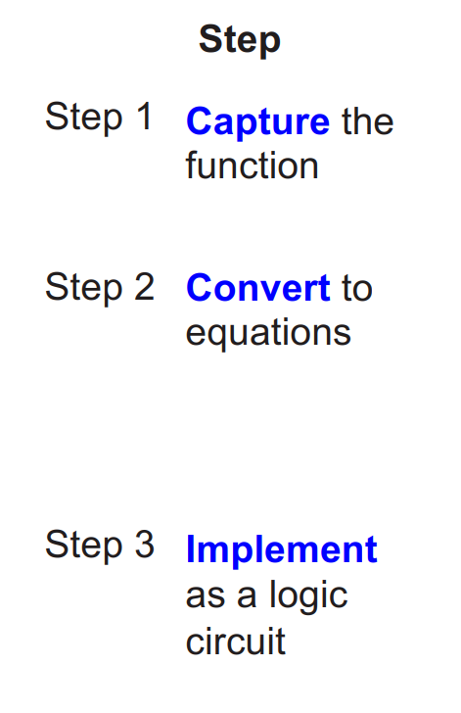
Combinational Circuit
How to Design a Combinational Circuit
By truth table/ equation
Simplify by K-map or Boolean algebra
With logic gates and blocks mentioned in slides
Pay attention to the format of the blocks

Slide 4
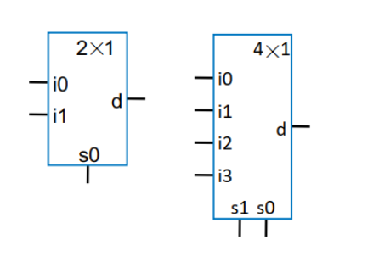
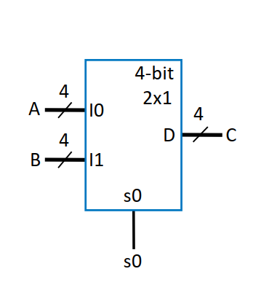
Combinational Circuit
MUX
Important Elements (Don’t forget anyone)
Block Label: m-bit N*1 mux
Input label: i0,i1,i2,…
Select Signal label: s0, s1,s2
Output label: d
If you are required to draw one single Mux, remember:
Input/Output signals: a, b, c, F
2x1 Mux / 4x1 Mux
4bit 2x1 Mux (with bus)

Slide 5
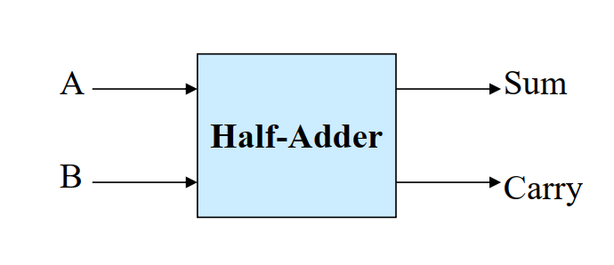
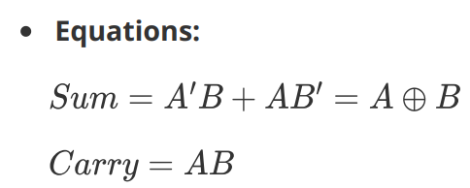
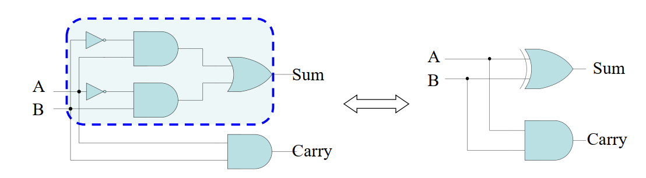
Combinational Circuit
Half adder (1 bit)
Important Elements
Block Label: HA
Input label: A, B
Output label: Sum(s), Carry(c)
Inner Structure:

Slide 6
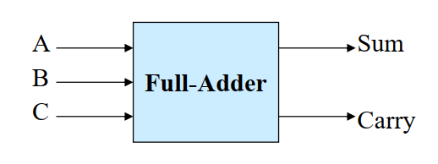
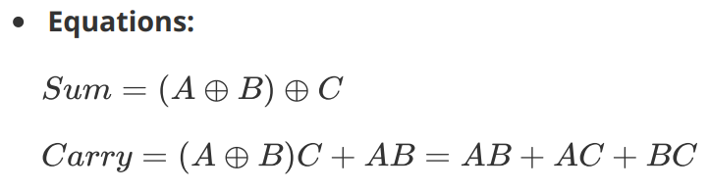
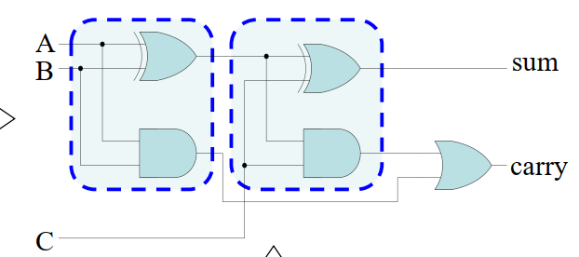
Combinational Circuit
Full adder (1 bit)
Important Elements
Block Label: FA
Input label: A, B, C
Output label: Sum(s), Carry(c)
Inner Structure:

Slide 7
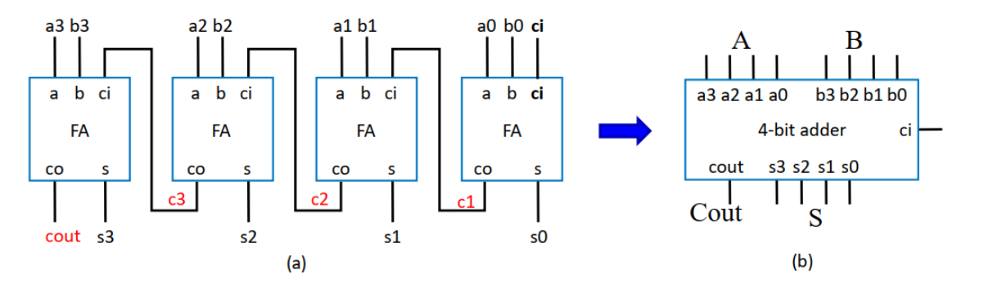
Combinational Circuit
Carry Ripple adder (N bits)
Important Elements
Block Label: N-bit adder
Input label: A(a0, a1,…), B(b0,b1,…), ci(1 bit)
(You can use bus here)
Output label: S (s0, s1,…), Cout (1 bit)

Slide 8
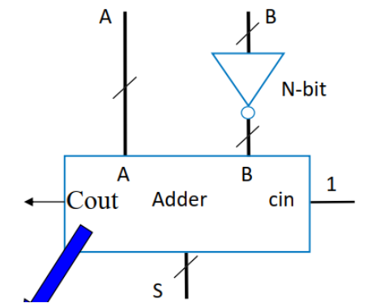
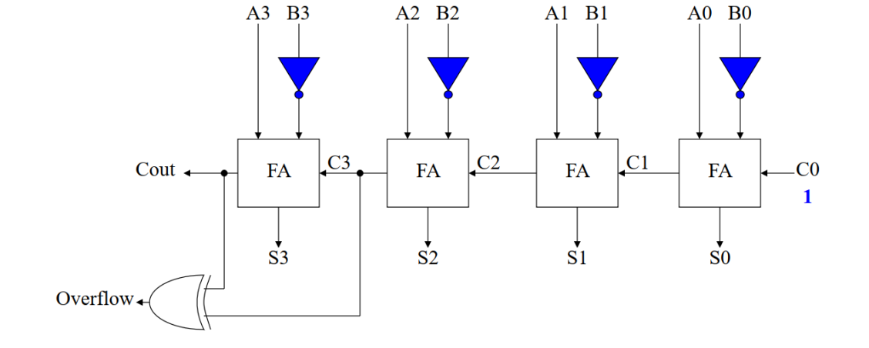
Combinational Circuit
Two’s complement Subtractor (N-bits)

Slide 9
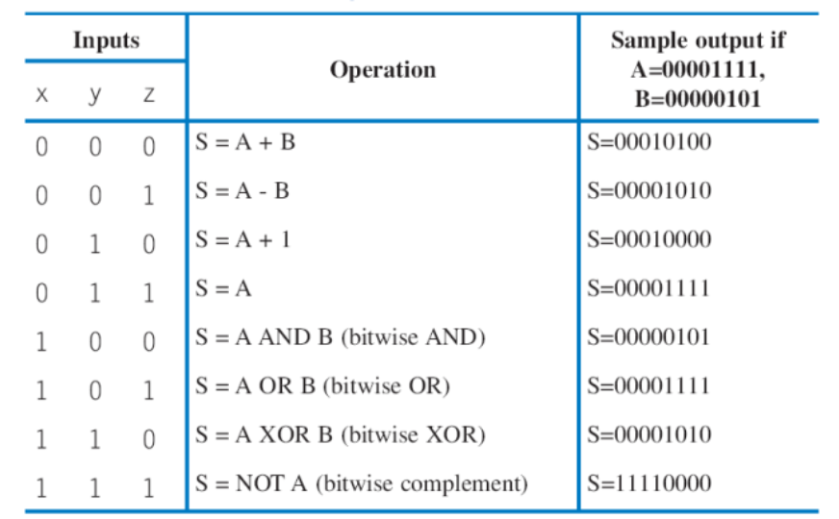
Combinational Circuit
ALU

Slide 10
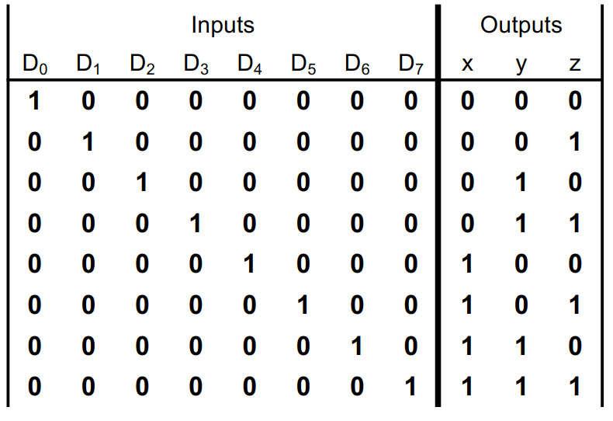
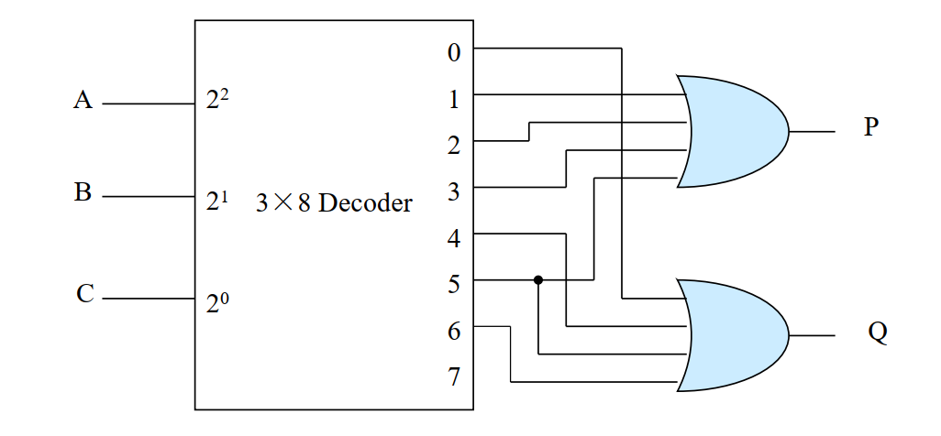
Combinational Circuit
Encoder & Decoder
Encoder
Each input is given a binary code:
Among all inputs, only 1 input equals to 1
Decoder
Convert binary code to one high output:
Among all outputs only 1 output equals to 1
Minterm Generator (easy to draw the form of sum of minterms)

Slide 11
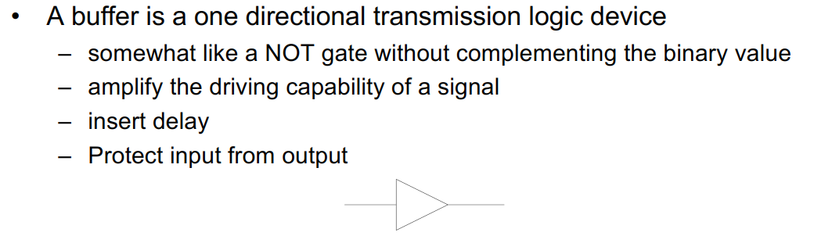
Combinational Circuit
Buffer

Slide 12
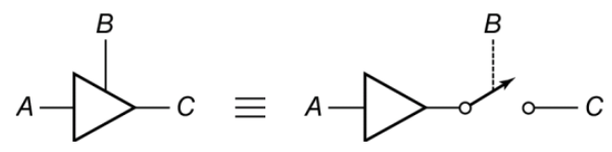
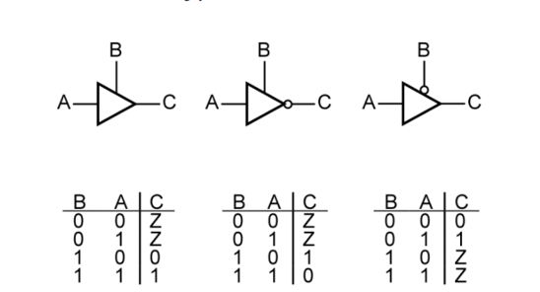
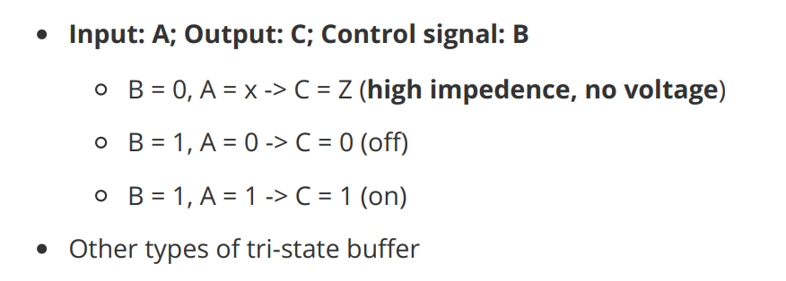
Combinational Circuit
Tri-state Buffer

Slide 13
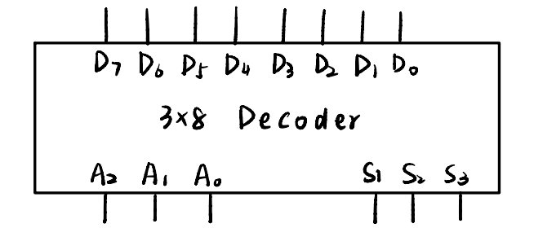
Combinational Circuit
Exercise

Slide 14
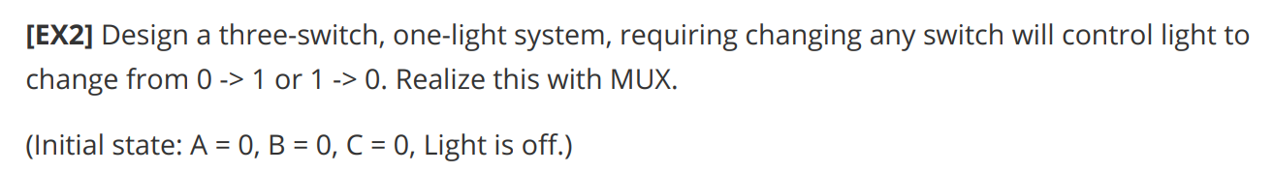
Combinational Circuit
Exercise

Slide 15
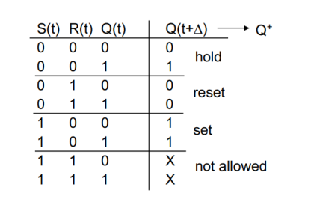
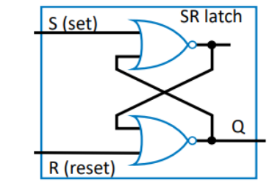
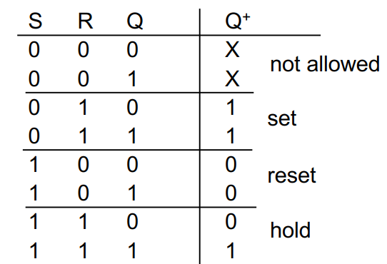
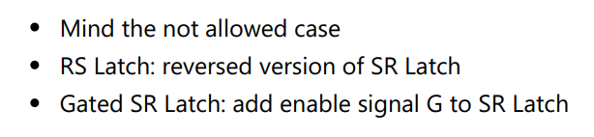
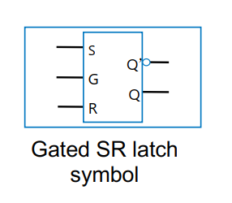
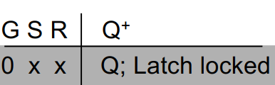
Sequential Circuit
SR Latch

Slide 16
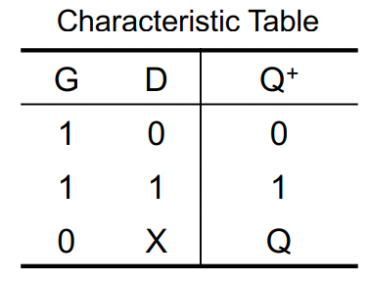
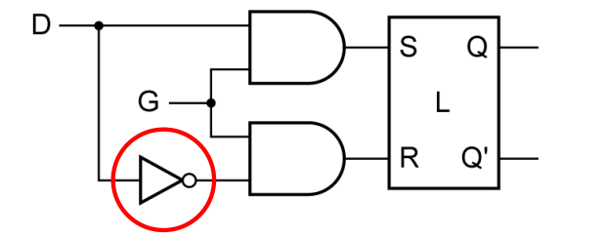
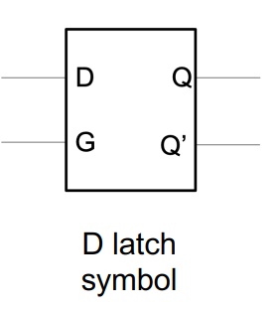
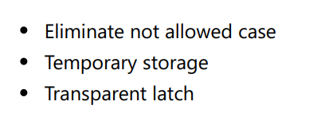
Sequential Circuit
Gated D Latch

Slide 17
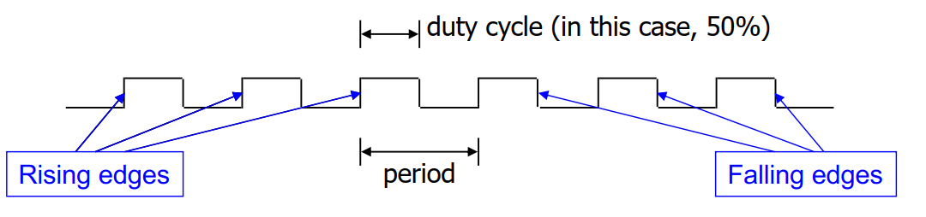
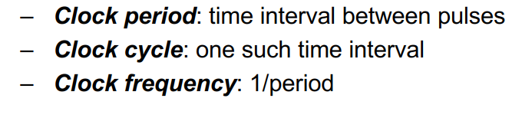
Sequential Circuit
Clock

Slide 18
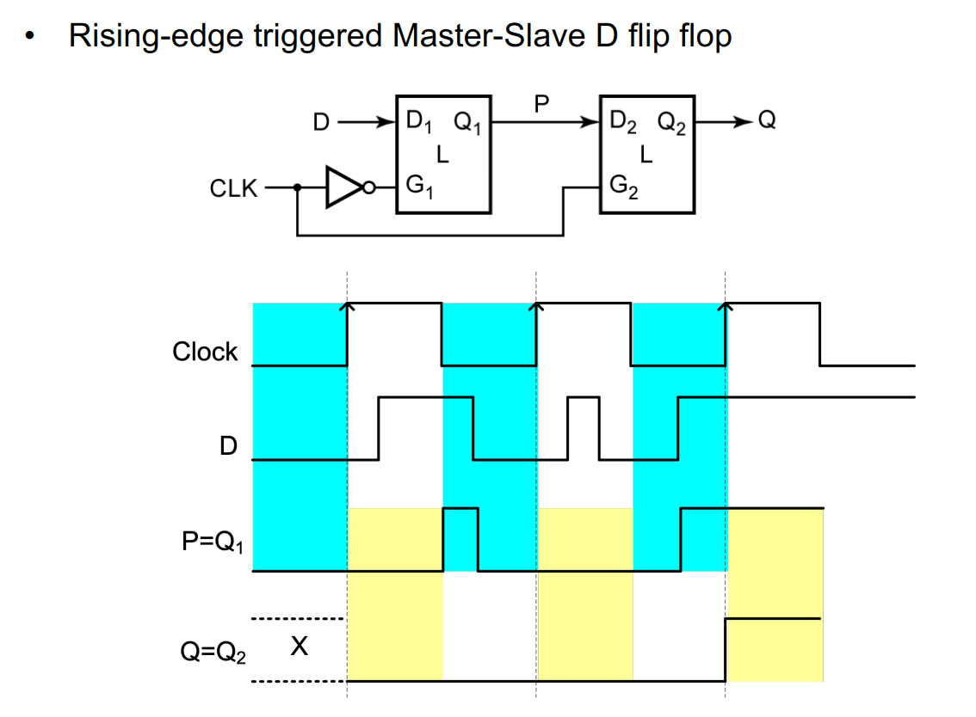
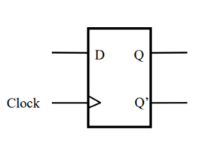
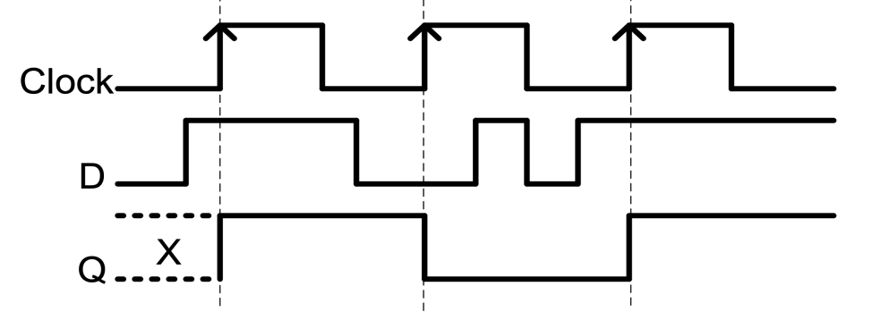
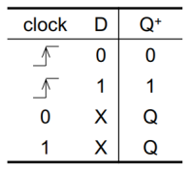
Sequential Circuit
﻿Rising-Edge Triggered D Flip Flop

Slide 19
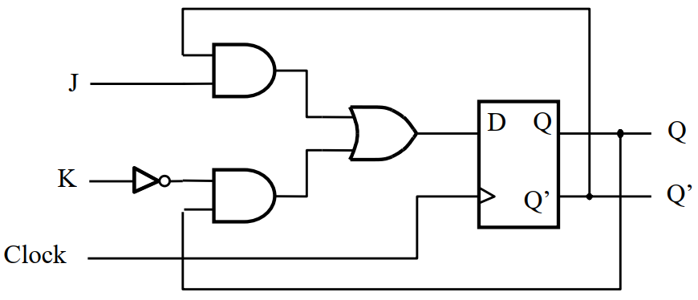
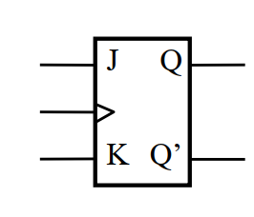
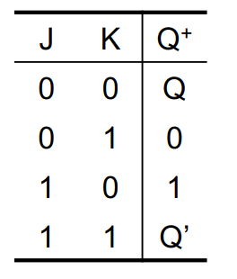
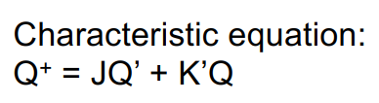
Sequential Circuit
﻿Rising-Edge Triggered J-K Flip Flop

Slide 20
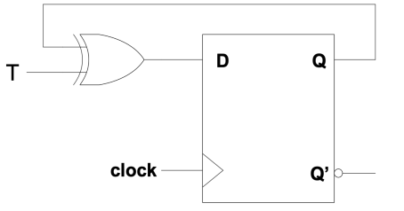
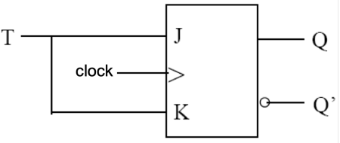
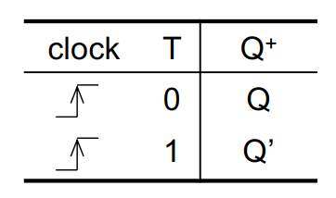
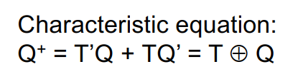
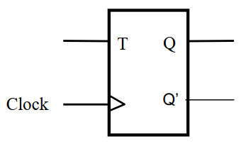
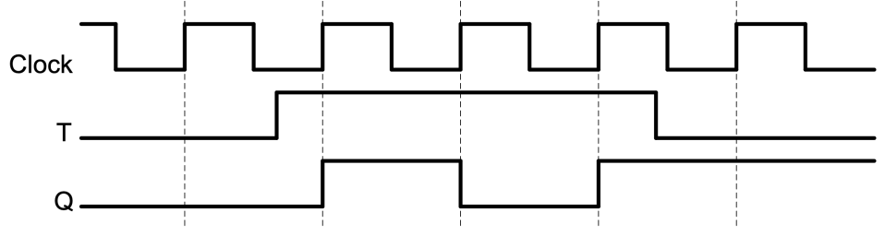
Sequential Circuit
﻿Rising-Edge Triggered T Flip Flop

Slide 21
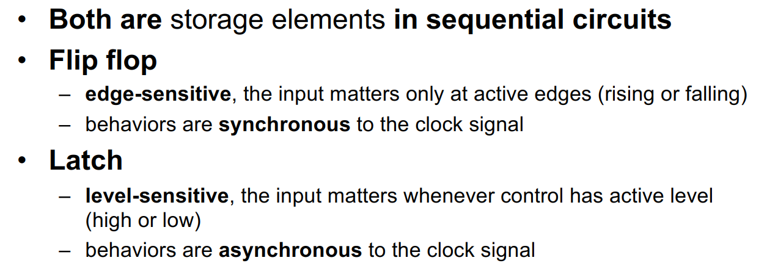
Sequential Circuit
Latch & Flip Flop

Slide 22

Sequential Circuit
Register

Slide 23



Sequential Circuit
Control Inputs for Flip Flops

Slide 24



Sequential Circuit
﻿Register with Synchronous Parallel Load

Slide 25
Counter
Definition of counters
﻿• A digital circuit that counts in different format: binary, decimal, signed, unsigned…
• An n-bit binary counter can count up to 2^n-1 numbers
• An n-bit binary counter consists of n flip-flops
• Count up or count down, increment or decrement once per clock cycle – counting number of clock cycles

Slide 26


Counter
﻿﻿Synchronous 3-bit Binary Counter with D Flip-Flop
Combinational & Sequential part
The combinational part is designed based on truth table

Slide 27


Counter
Load in counter

Slide 28


Counter
Counter with Count Enable and Load
Reset > Load > Count Enable

Slide 29


Counter
Clock Divider: Example divide by 6
Frequency is divided - ﻿– Generates clock signal with bigger clock cycle

Slide 30

Counter
﻿﻿Asynchronous 3-bit Binary Counter with T Flip-Flop
Get familiar with the samples in slides
Probably you will be asked some models in the choice questions
﻿Problem: asynchronous counter：
– Delays caused by each stage – timing issues
Clock skew: difference in arrival time of clock signal between two sequentially adjacent registers

Slide 31

Counter
﻿Synchronizer
﻿Synchronize the output by a D flip-flop
﻿Synchronizer delays the input asynchronous signal by up to 1 clock cycle
– But aligns the synchronized signal with clock
– Clock skew is not completely removed, only reduced

Slide 32

Counter
﻿Synchronized Clock
Proper frequency is
given to the synchronizer

Slide 33



Counter
More Counters
Ring counter
Johnson counter
BCD counter

Slide 34

Counter
Design Counters
General step:
Build truth table for each Q+ based on output Q
Modify the combinational part according to the truth table
Exercise: Design a counter to Count from 2-5 (Hint use load)

Slide 35
Counter
Design Counters

Slide 36

Counter
Up/Down-Counters
Incrementer/Decrementer can be used directly
Learn to figure out the function of each input from the circuit

